Slide 1




[WRO] 16 spotkanie Microsoft Azure User Group Poland we Wrocławiu
Piotr Rogala
Partnerzy

Slide 2

Hasło AZURE

Slide 3

Sponsor spotkania:

Slide 4
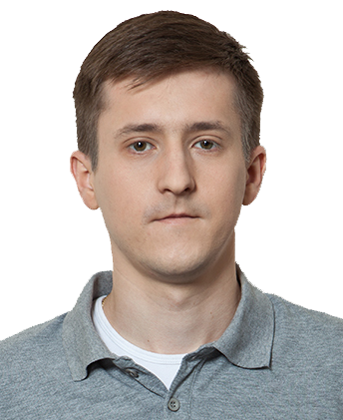

About Me
Current working in Nordcloud
Azure Cloud Architect
MVP Azure
Blog: justcloud.pl
FB Page: facebook.com/justcloudpl
Group leader:
Microsoft Azure User Group Poland

Slide 5
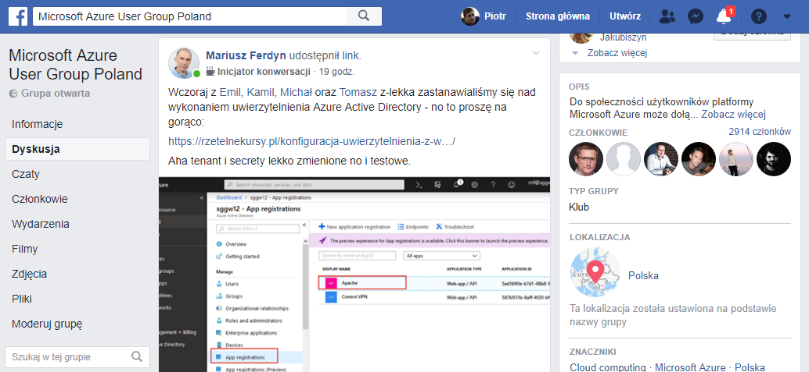

Wrocławska Grupa Microsoft Azure User Group Poland
https://www.facebook.com/groups/azureugpl

Slide 6






Grupy we Wro
Cloud4IT
https://www.meetup.com/Cloud4it-Group/
DevOps Wrocław
https://www.meetup.com/Wroclaw-DevOps-Meetup
PPOSH
https://www.meetup.com/Polish-PowerShell-Group-PPoSh
Wrocław .NET User Group
https://www.meetup.com/wrocnet
MAUGP
http://azureug.org
SysOps Polska
https://www.meetup.com/SysOpsPolska

Slide 7

CloudPoland
Rejestracja: http://slack.justcloud.pl

Slide 8

https://www2.nordcloud.com/azure-migration-roadshow-pl-wroclaw/

Slide 9

KODAWANIE
http://bit.ly/kodawanie
http://bit.ly/kodawanie_fb

Slide 10
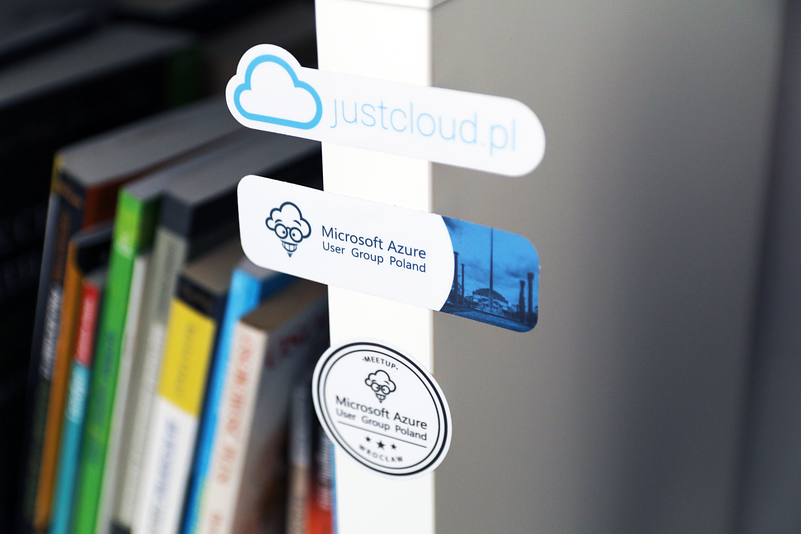
Stickers

Slide 11
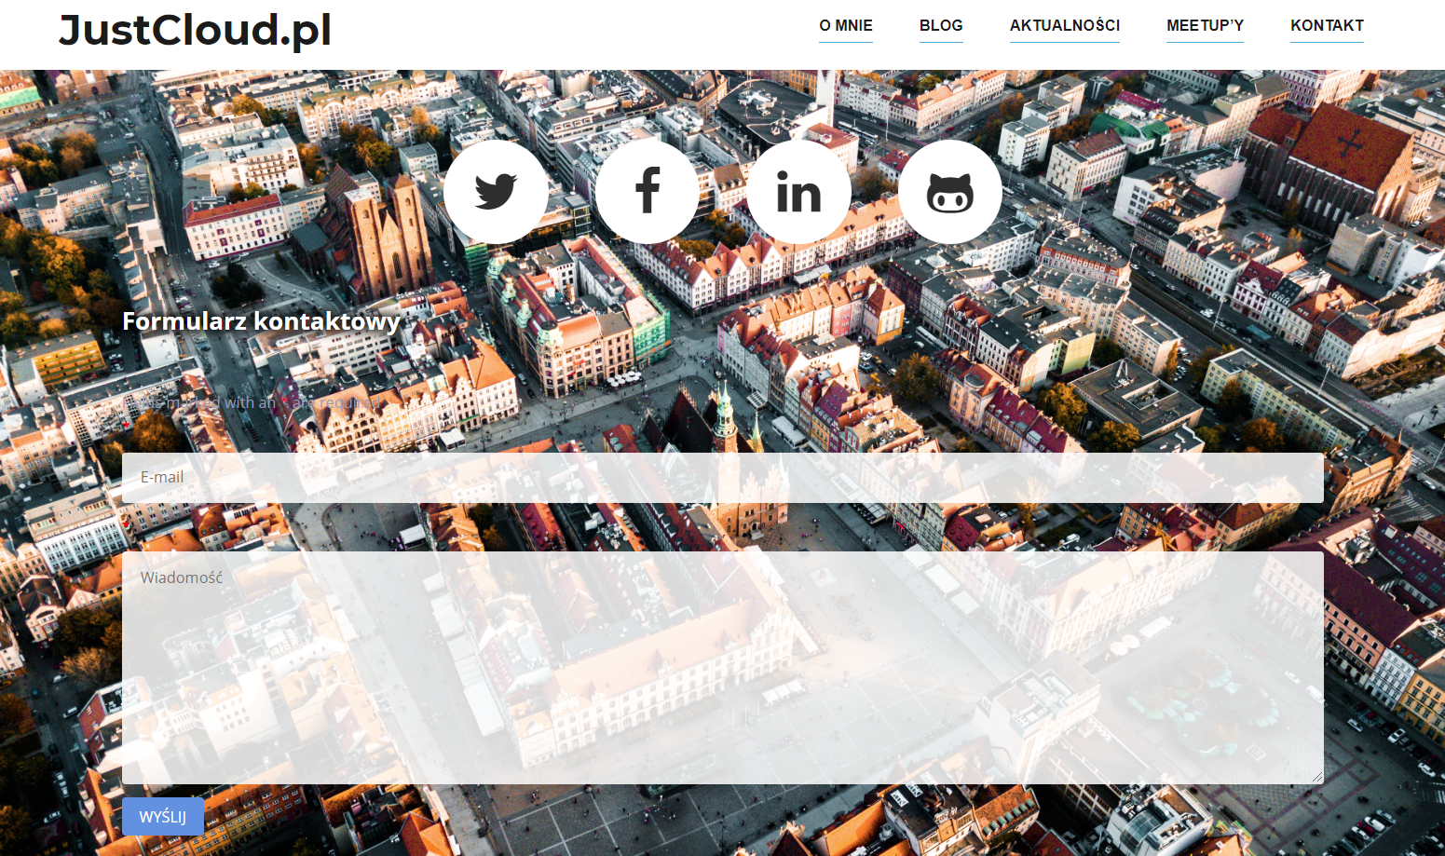
Questions?

Slide 12
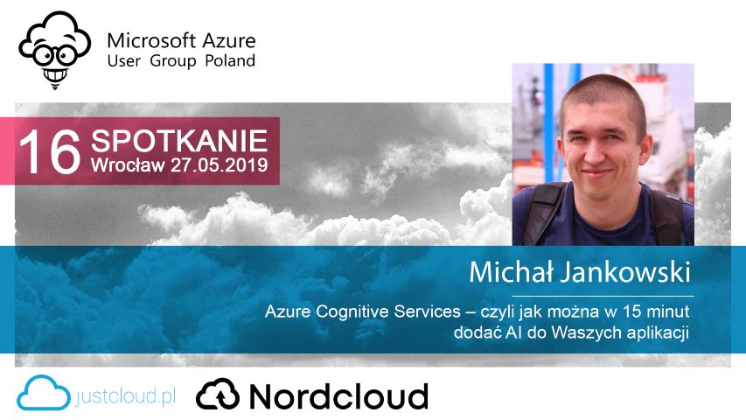

Slide 13
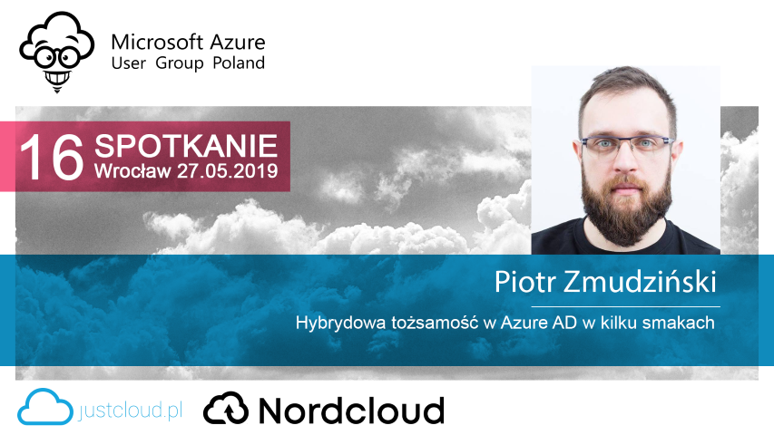

Slide 14
